Slide 1



PnP Transformation Architecture Design – Kick off
<Consultant Name>
<Job Title>
<Company Name>

Slide 2
Agenda
Introduction to PnP Transformation Design Phase
Your current status in the transition
Your app model solution areas
Solution design discussion
Free form discussion on the topics
Feel free to share any of your content during the call
Other expectations
Next steps

Slide 3
PnP Transformation Program Overview
Empower and Plan
Develop and Deploy
Customer Readiness
FTC to App Assessment
Architecture session
Development/testing
Deployment
Prepare app hosting options
Leverage available resources to ramp up dev resources
Analyzing complete inventory and help providing guidance on FTC to app roadmap
For selected scenarios provide architecture design guidance
Development and testing jointly with an MS partner.
Retract FTC
Deploy App solutions
Deliverable:
Successful smoke test app to validate configuration
Deliverable:
Assessment report
Deliverable:
Architecture Design Doc
Deliverable:
Tested solution artifacts
Deployment Guide
Deliverable:
Replace FTC by APP
Project signoff
Post DB upgrade
Farm max compatibility is 15
Make hosting choice
Procure hosting infrastructure
Requirement document
FTC inventory
Final requirement document
Assessment report
Requirement document
Architecture Design
Deployment Guide
Engagement Criteria
Customer
Internal resource readiness
Set up hosting infrastructure
Complete configuration
Live demo
Requirement review
Prioritize requirements
Solution design proposal
Architecture Design Workshop
Successful Proof of Concepts as needed
Review assistance and technical support for the technical team
Roles & Responsibilities
MS Partner

Slide 4




Provider hosted environment status?
Team and schedule status?
Enterprise-grade cloud
Essential productivity services
Your current status?
Business requirements known?
Solution design status?
Flexibility and choice
Familiar and easy

Slide 5

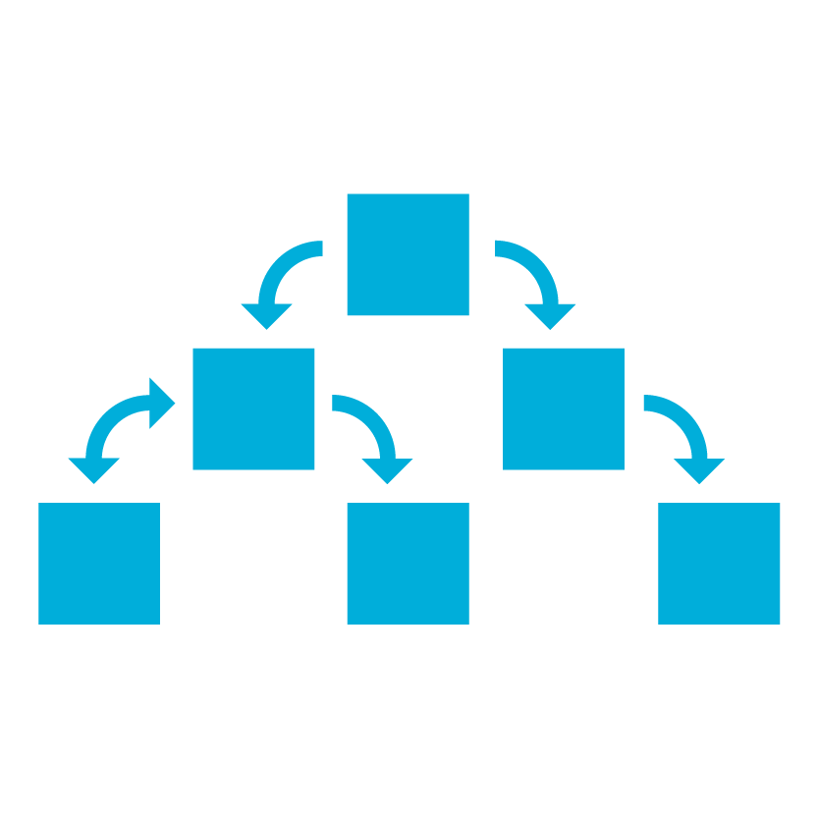
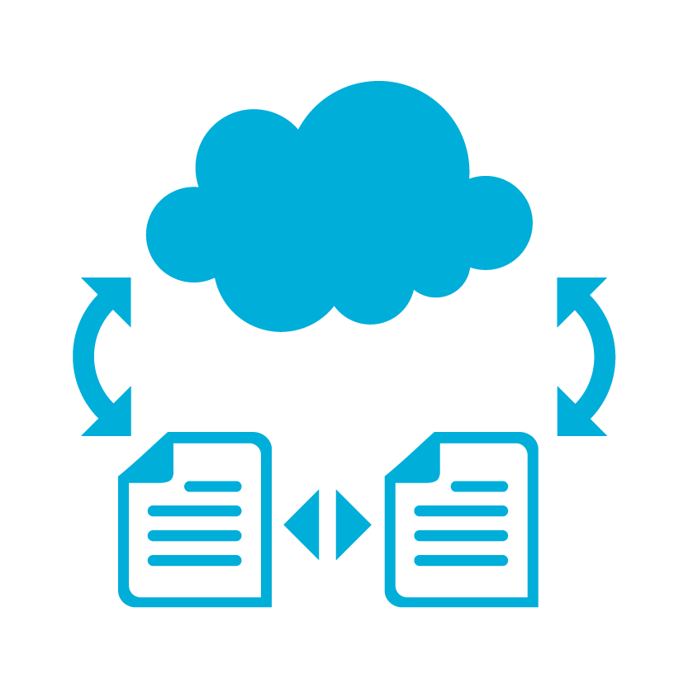


Your solution areas Based on previous discussions…
Site collection provisioning
Provisioning to host web
Customize OneDrive 4B
Branding with app model

Slide 6

App model Solution design discussion…

Slide 7

Your expectations?
What are your expectations right now?
What kind of input you’d need now to help you transition to the APP model?
Some other challenges which you’d like to be addressed?
Any immediate inputs on the code and approaches?
Notes:
Is the customer already on SP 2013, post DB upgrade, preferably post Site Collection Upgrade?
Do they have committed schedule or plan to move to APP model?
3) Do They have development resource for APP

Slide 8


Transform your code Providing App Model Patterns for common Full Trust Code scenarios
50+ Visual Studio projects Common scenarios
Branding
Site provisioning
Remote event receivers
Large file support
Taxonomy driven navigation
And much more…
Contribute
This is open source project and open for contributions
Developer
Patterns & Practices
aka.ms/OfficeDevPnP

Slide 9

Questions?

Slide 10


© 2014 Microsoft Corporation. All rights reserved. Microsoft, Windows, and other product names are or may be registered trademarks and/or trademarks in the U.S. and/or other countries.
The information herein is for informational purposes only and represents the current view of Microsoft Corporation as of the date of this presentation. Because Microsoft must respond to changing market conditions, it should not be interpreted to be a commitment on the part of Microsoft, and Microsoft cannot guarantee the accuracy of any information provided after the date of this presentation. MICROSOFT MAKES NO WARRANTIES, EXPRESS, IMPLIED OR STATUTORY, AS TO THE INFORMATION IN THIS PRESENTATION.

